Slide 1
Assignment - 1 Software Product Management Group - 49
Submitted by
Santosh P Katageri (2022MT93129),
Sarthak Jha (2022MT93151), Satish Kumar Sharma (2022MT93327),
Sattwik Kumar Panda (2022MT93364),
Saurabh Paul (2022MT93355)
1

Slide 2

Domain and Product Idea
AI Enabled Document Information Extraction System (Healthcare Information Extractor - HIE)
This AI-enabled system processes large-volume medical documents and extracts key information from the texts. It converts these unstructured data into structured data.
Medical documents (Electronic Health Records, regulatory & clinical documents) contain key information as unstructured text. These include information such as disease, drugs, composition, treatment regimes, labels, and regulatory approval status.
Often, it’s difficult to extract these using rule-based systems. So, Natural Language Processing (NLP) techniques and AI algorithms such as named entity extraction (NER), Classification Models, and topic modeling are used to automatically detect and extract these key entities.
This system can process both machine-readable PDFs and non-machine-readable PDFs. It applies Optical Character Recognition (OCR) techniques to convert scanned documents to machine-readable format.
The system loads the extracted data onto the database which is further used by the Business team.
AI enabled
Healthcare Information Extractor
(HIE)

Slide 3
Product Details
Product Description:
HIE is a web application SaaS implementation to extract information from text documents (e.g., PDF, MS Word, etc.) based on semantic search, ontology mappings, and named entity recognition.
Key Features:
Upload documents (single or in bulk) and view all documents on the browser.
Visualize the PDF content on the browser itself.
Search and highlight key phrases on selected PDF document.
Semantic search capability on the full set of documents.
Ontology-based mapping and extraction of domain-specific entities.
NER models to tag, highlight and extract domain-specific entities.
Output pane to visualize the results on the browser itself.
Export option to provide results in multiple formats such as XLS, JSON capability.
Additional Features:
Provide an option to select the NER model from the list.
Implement prompt engineering to provide the user more flexibility to customize the parameters (Require more investigation)
Implement the OCR feature to read non-machine-readable PDFs to machine-readable documents
Implement API endpoint for real-time extracted search result sets
Note: Pointers in BLUE are after re-assessment of customer feedback

Slide 4
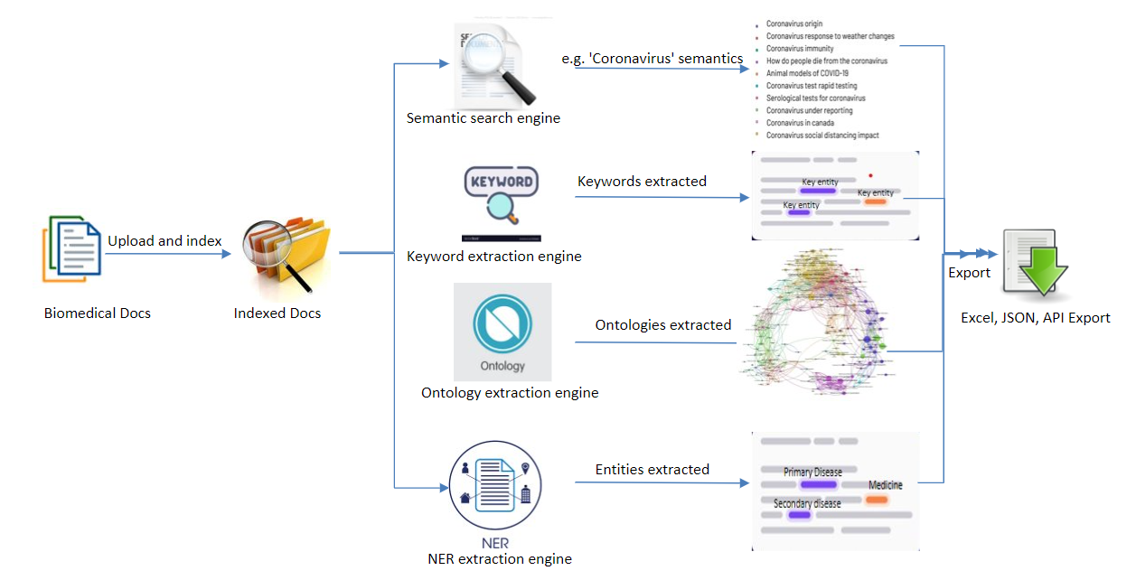
Product Details (Contd..)

Slide 5
Target Market and Audience
HIE is a B2B SaaS product for Healthcare Domain to be helpful in extracting from real-world sources.
Target Market:
Europe
United States
Canada
United Kingdom
APEC (Japan & Australia)
Target Companies:
Pharmaceuticals
Health Technology Organizations
Biotech companies
Clinical Research Organizations
Target Audience (SMEs) within Biomedical:
Medical Writing
Regulatory Affairs
Market Access Teams
Health Technology Assessment
Clinical Assessment
Drug Pricing and Reimbursement

Slide 6
Pain Points to Solve
Real-World Data Extraction:
RWD is significant data for the Healthcare and Life-science industries and extracting this data with accuracy and efficiency is challenging.
Unstructured Data Processing:
Healthcare and Lifesciences domain require extracting information from unstructured data sources and efficient extraction approaches are sought after by SMEs.
Limitations of Document Search:
The keyword-based search approaches have limitations in extracting information that are not exact matches yet semantically similar. Hence the current approaches miss out on relevant information.
Lack of End-to-End Platform:
A common platform is warranted to upload & store documents, perform searches, extract key information, visualize the results, and export the result to the required format.

Slide 7
Value Proposition
HIE - it provides powerful natural language processing (NLP) and text analytics software solutions that enable organizations to extract meaningful insights and knowledge from unstructured data, particularly in the healthcare and life sciences industries.
Note: This resolves the first three underserved needs of the industries from the previous slide.
HIE's software is designed to help users quickly and accurately analyse large volumes of text data, identify key concepts and relationships, and gain a deeper understanding of their data.
Note: This resolves the last underserved need of the industries pointed in the previous slide.

Slide 8
Market Opportunity Assessment
The global real world evidence solutions market size was valued at USD 42.4 billion in 2022 and is expected to expand at a compound annual growth rate (CAGR) of 8.2% from 2023 to 2030. Support from regulatory bodies for using Real World Evidence Solutions (RWE) and an increase in R&D spending are anticipated to boost market growth.
~ Report by Grand View Research
The global NLP in healthcare and life sciences market size is projected to reach USD 7.2 billion by 2027 from USD 2.2 billion in 2022, at a CAGR of 27.1% during the forecast period.
~ Reports by Markets and Markets Analysis
The global NLP market will grow from USD 7.5 billion in 2020 to USD 43.1 billion by 2026, at a CAGR of 32.4% during the forecast period.
~ Report by Zion Market Research
HIE’s solutions are well-positioned to capitalize this market opportunity, as we will be providing NLP and text analytics tools specifically tailored for the healthcare and life sciences industries.
Currently, there are not many competitors in this domain.

Slide 9
Customer Idea Feedback
S. No. | Customer Name | Customer Feedback | Related Product Module | Potential Significance (Initial Assessment) | Action Item
1 | A | Client expected to have the performance of the search and extraction equivalent to Commercial large Language Models Customer has varying scope of search for drug related information | Search & Extraction | High | Benchmarking of in-house capabilities vs Large language models Identify features of LLMs that can be integrated with the HIE platform. Multiple Extraction pipelines will be required for different sub domains
2 | B | The client suggested having the capability to integrate the search and extraction results with external visualization tools. The client suggested having functionality to download the search and extraction results in PDF format that can be shared among client team via email. | Visualize & Export | Low | Need to explore the possibility of integrating search results with client specific visualization tools. Assessment of email export functionality
3 | C | The client suggested for the handling of scanned documents | Upload & Indexing | Medium | Assessment of OCR feature
4 | D | The client suggested having an API endpoint for querying and extracting results from the HIE platform. | Export | High | Assessment of API endpoint feature
5 | E | The client was concerned with the handling of the limitations of NLP capability. | Search & Extraction | Medium | Benchmarking of in-house capabilities vs SOTA models Monitoring framework for model performance assessment

Slide 10
Idea Modification based on Feedback
Proposed Ideas:
Search:
Integration of LLMs with search functionality
Extraction:
Improved scope of extraction models
Export:
Integration with commercial visualization tools
Efficient export of search results API endpoint
Email share functionality
Upload & Indexing:
Implementation of OCR functionality for scanned documents
Monitoring:
Monitoring Framework for implemented AI models

Slide 11
Finalized Idea & Value Proposition after Reassessment over Proposed Feedback
Search:
LLMs are trained on general datasets and are not finetuned for the biomedical domain. However, we customized NLP models trained on curated Biomedical concepts. So, there is no need to integrate LLMs with the HIE platform. The prompt engineering feature which is native to the LLMs will be implemented in release 2.
Value Proposition: This prompt engineering will give the user flexibility to design the search query by feeding with
examples so that the search out is optimized and re-formatted based on the user's need.
Extraction:
Additional NLP models will be trained and deployed over time to gradually enhance the scope of the extraction module
Value Proposition: Enhanced information extraction capability (e.g - ICD code extraction, Document Segmentation etc.)
Export:
Efficient export of search results API endpoint.
Value Proposition: It will give the client the ability to integrate the HIE platform with their existing pipelines.
Integration with commercial visualization tools is out of scope now. The results can be queried through API and then can be integrated with downstream processes at client's end.
Email share functionality would not add much value. The results can be queried through API and then can be shared among client teams. Hence this is out of scope for now.
Upload & Indexing:
OCR functionality for scanned documents can be implemented in release 2
Value Proposition: Extended document handling capability by adding an OCR module
Monitoring:
Monitoring Framework will be deployed as part of NLP model deployment and will continuously monitor the performance of the search and extraction module.
Value Proposition: Early warning on model drift. The models can be retrained.

Slide 12
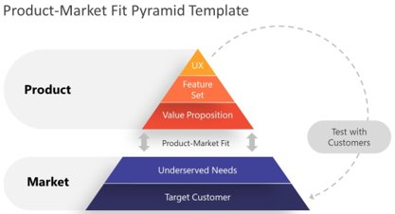
Final Product Scope
Scope:
The initial scope is to implement the key features for healthcare-specific documents.
The initial scope will be implemented for PDFs including scanned documents.
Requirements listed under ‘Additional Features’ will be implemented in release 2.
The core functionality of the search can be extended to other domains as well. However, it would require the ontology and NER-based extraction logic to be adjusted for the domain.
API endpoint will be made available
Prompt engineering feature will be integrated
Note: Based on the target customer feedback and underserved needs determined by number of tests with customers, we have improved the scope of the final HIE draft.

Slide 13
Story Map: AI-Enabled Healthcare Information Extraction (HIE)
Upload &
Indexing
Search & Extraction
Visualize & Export
User
activities
Register or Login
Upload Documents
Keyword Search
Ontology Search
Context Search
NER based Information Extraction
Export Results
User
tasks
Visualize the PDF content on the browser
Search and highlight key phrases on selected PDF document
Semantic search capability on the full set of documents
Ontology-based mapping and extraction of domain-specific entities
NER models to tag, highlight and extract domain-specific entities
Output pane to visualize the results
Release
1
Export results in XL and JSON
User
stories
Provide an option to select the NER model from the list.
Implement prompt engineering to provide the user more flexibility to customize the parameters
Export and Publish data in API
Release
2
Implement OCR feature to read non-machine-readable PDFs
13

Slide 14
Business Plan (HIE - Lean Canvas)
Problem Real World Data Extraction Unstructured Data Processing Limitations of Keyword based search Lack of end-to-end document processing platform | Solution End-to-end platform Semantic Search capability NER-based information extraction | Unique value proposition Large volume document search Sematic search NER models Export features through APIs |  | Unfair Advantages End to End Document search and Information extraction platform in Life-science / Healthcare Real world data extraction space AI enabled search and information extraction | Customer Segments B2B SaaS product for Biopharmaceuticals and Health Tech organizations working on real world data extraction
 | Key Metrics # of docs indexed TAT for search & extraction Accuracy of NLP models |  |  | Channels Website Business Development Partership with Consulting Companies
Cost Structure IT Infrastructure cost Research & Development – Framework, NLP model, etc. Business Development |  |  | Revenue streams User subscriptions to HIE Enterprise Product Integration and customization licensing Consulting fees for niche data extraction projects for clients
Product
Market

Slide 15
Key learnings by Santosh P Katageri (2022MT93129)
This assignment helped me to gather and understand in-depth knowledge about product development. I can summarize my key learnings from this coursework as shown below.
Understood assessing the market fitment of the product and targeting the right market.
This help me in understanding the end-to-end product development process from start to usable product.
Got a chance to apply the theoretical concepts like value proposition, business plan, story map, and lean canvas for any product idea from scratch.
Understood the process of idea assessments and re-assessment based on customer feedback and discussions.

Slide 16
Key learnings by Sarthak Jha (2022MT93151)
Learned to develop domain specific vocabulary, and terms to ensure the product was accurate and relevant.
Learned ways to ensure that only high-quality annotated training data was fed into product to improve the product's performance.
Learned how to do selection of right algorithms for specific tasks to optimize the product's functionality.
Learned to adopt an iterative development process to incorporate user feedback and improve the product's performance over time.
Collaborated with customers and partners to gain insights into specific use cases and requirements and guided the development process.

Slide 17
Key learnings by Satish Kumar Sharma (2022MT93327)
My key learnings are summarized as below:
I Learned to create complex products that address consumer friction while also understanding the ecosystem that supports them.
Developed the ability to locate a clear value proposition for the entire product ecosystem, and critical opinion leader to support it.
I learned how to evaluate the technology and tools used to create our cutting-edge product. (Ex. model built on AI)
I learned how to trade-off with stakeholders and pitch investors.
Learned how to finalize product scope, write stories, story mapping and the one-page business model.
How to design the routines and systems around the product as a SaaS product.
How to overcome the challenges of building and managing highly scalable distributed systems

Slide 18
Key learnings by Sattwik Kumar Panda (2022MT93364)
The assignment has been instrumental for me in learning the product development journey from ideation through market release. My key learnings are summarized as below:
Conceptualize the product idea and break it down into achievable goals; identify core features as well as good-to-have features.
Developed an understanding of how technology stacks can be integrated to build a scalable SaaS application. Learned how AI can solve key pain points in the healthcare industry.
Learned how market assessment can be essential for product development strategy. The knowledge of the target audience, geography, and potential customer base can help to better position the product.
Collaborated with customers to gain an understanding of customer needs. Developed ability to align the product pipeline with value proposition towards client's needs.
Learned to develop a story map for key modules as per the release plan.
Examined the various components of the business plan and collaborated on the lean canvas. Learned to identify key features, value propositions, and customer segments. Developed understanding of different revenue models.

Slide 19
Key learnings by Saurabh Paul (2022MT93355)
This was a very rich learning experience to understand the software product management journey based on these assignment pointers. Hence this is a good opportunity for us to retrospect our key learnings and probably have a thread dedicated to the same.
While working on this solution and product opportunity I have gained knowledge in the below-mentioned areas:
Got the opportunity to learn and understand customer requirements, necessities, and pain points to convert them to product opportunities and manage product development at all stages of its lifecycle.
Learned to develop adequate business models, road maps, and Go-To-Market strategies for the product.
I have also learned about areas involved in life sciences and healthcare tech information extraction and challenges in various software integrations in this field. Since this field is very new to me hence it was a very rich learning experience for me, domain-wise as well.
Got an understanding of the value proposition of a product idea and market fitment pyramid. Also understood Story Maps, and Lean-Canvas along with an understanding of business models, and conversion of the product idea to a story map.
Also learned about the 5 key critical areas of product management: PRODUCT, PRICE, PROMOTION, PLACE, AND PEOPLE.

Slide 20
Thank You

